Slide 1
Big Data, Learning Analytics and Education
Aleksanda Klašnja-Milićević
Mirjana Ivanović

Slide 2
Introduction
Big data - large, massive volume of data difficult to be processed by traditional and standard software and database techniques.
Term - Web search companies - extract useful information from extremely large distributed aggregations of loosely-structured data.
Big data - great potential for improving business in companies, healthcare, e-learning, and in wide range of data-driven industries and provide support for more intelligent decisions.
2

Slide 3
Definitions
Understanding and definition of big data:
depends not only on a massive amount of data but
also have to consider what the technology and which size of big data that technology could handle
2001 by Laney - ‘Big data can be characterized by the three Vs:
‘volume’ - very large volume of data (expressed in terms of terabytes, records, transactions, tables, files),
‘velocity’ - rapid generation (expressed in terms of batch, near time, real time, streams) and
‘variety’ - various modalities (expressed in terms of structured, unstructured, semi-structured, or of all mentioned)’.
3

Slide 4
Definitions
In 2011, an International Data Corporation (IDC) - ‘big data technologies describe a new generation of technologies and architectures, designed to economically extract value from very large volumes of a wide variety of data, by enabling the high-velocity capture, discovery, and/or analysis.’
According to this big data are summarized as four Vs:
Volume (very large volume of data),
Variety (various modalities),
Velocity (rapid generation) and
Value (huge value but very low density).
4Vs definition has been widely accepted as it indicates serious problem in big data: how to find out values from datasets with a massive scale, diverse types, and hasty generation.
4

Slide 5
Big data analytics
It is the process of collecting, organizing and analysing large sets of data with intention to discover patterns of data and some other useful and important information.
An instrument to discover the knowledge that is behind the analysing data.
To analyse such a huge volume of data, big data analytics have to use specialized:
high-performance analytics techniques and tools for data mining,
data optimization,
predictive analytics,
forecasting and so on.
5

Slide 6
Trends in Contemporary Education Environments
Higher education institutions - more data than ever before.
Analysis of the amount of learning data:
which learners are at risk of dropping out or need additional support to increase their success, and confidence, in the learning process.
new or novel approaches are required to understand the patterns of value that exist within the data.
Lot of exploration and researches aim to handle the data with the proper techniques and new tools to produce real time solution, prediction in this certain area.
6

Slide 7
Trends in Contemporary Education Environments
Big data can advance higher education practice:
more effective self-learning
improving learners experience and knowledge
more effective evidence-based decision making
create useful peer groups and
enable teachers to identify intercessions,
strategic response to change global trends
free up class time for creativeness and problem solving
7

Slide 8
Trends in Contemporary Education Environments
Prediction
future uses of learning sequences
Structure discovery
discover important relationships between students and students’ scores
Relationship mining
discover relationship between the usability of the course materials and the students’ learning performances
Distillation of data
distil data in different ways and for different purposes for further use in human management
on final learners’ grades
students’ knowledge behavior
8

Slide 9
General process of mining insights from big data
Data
Information
Knowledge
Practical value
Desicion making
Evaluation
Synthesizing
Summarizing
Classification
Collecting
Typical measurements:
cover time spent,
number of logins,
number of mouse clicks,
number of accessed resources,
number of finished coursework, etc.
9

Slide 10
Capabilities of an e-learning system
Response time
Major capabilities of an e-learning system
Interactivity
Functionality
The e-learning system is designed to allow access to the system at remote locations, providing anytime and anywhere access to course content, which is critical for promoting the use of e-learning systems
10

Slide 11
Why Associate Big Data and Learning Analytics Together?
11

Slide 12
Benefits of Big Data and Learning Analytics
Progress in order to predict future performance.
Recognize potential concerns related to academic programming, research, teaching and learning.
Collected processes designed at estimating institutional performance.
Big data signifies the interpretation of a wide array of administrative and effective data.
13

Slide 13
Educational performances
Feedback:
predict learner outcomes such as:
dropping out,
needing extra help, or
being capable of more demanding assignments.
Motivation:
If the big data is appropriately implemented, learners possibly become invested in entering data to the process because they understand the impact of how it works.
Personalization:
allowing designers to personalize courses to adjust their learners’ individual needs.
developers to promote the standard for effective and exceptional e-learning courses.
14

Slide 14
Educational performances
Efficiency: save many hours of time and effort when it comes to the achievement of our goals and strategies that we need to achieve them.
Collaboration:
cooperation,
teamwork, and
interdisciplinarity thought processes.
Tracking: teachers to understand the real patterns of learners more effectively by allowing them to track a learner’s experience in an e-learning course.
Understanding the learning process:
which parts of a course or exam were difficult or easy
pages revisited often,
sections recommended to peers,
preferred learning styles, and
the time of day when learning operates at its best.
15

Slide 15
The Application Development Framework
For any big data platform - an application development framework which can make simpler:
the process of development,
execution,
testing, and debugging appropriate educational software components
and building blocks.
Such type of framework should contain:
model development tools and techniques;
capability for program loading, implementation, and process scheduling;
the system configuration and management tools.
16

Slide 16
Several technologies to handle big data
Map-Reduce,
Hadoop,
NoSQL,
PIG and
Hive.
Databases for managing data of this size are generically known as NoSQL databases - “not only SQL".
NoSQL databases are simpler than SQL databases in terms of data manipulation abilities, but can handle larger amounts of data.
17

Slide 17
Several technologies to handle big data
One of the most known and significant tools commonly used by most data management systems is Hadoop.
Hadoop is an open-source software framework for storage and processing big data in a distributed fashion on large clusters of commodity hardware, using simple programming models.
Principally, it achieves two tasks: large data storage and faster processing.
18

Slide 18
Several technologies to handle big data
Hive
Data warehouse framework built on top of Hadoop
Used for ad hoc querying with an SQL type query language - more complex analysis
Designed for batch processing, not online transaction processing
Does not offer real-time queries
Pig
High-level data-flow language (Pig Latin) and
Execution framework whose compiler produces sequences of Map-Reduce programs (for execution within Hadoop)
Each Pig Latin program consists of multiple steps, each step being a type of query
Support ad-hoc data analysis
Data can be queried directly without the need for importing into tables
19

Slide 19
several technologies to handle big data
Mahout
project for building scalable machine learning libraries, with most algorithms built on top of Hadoop and using the Map-Reduce paradigm
HBase
distributed, scalable, big data store that runs on top of HDFS
provides random, real time access to big data
was created for hosting very large tables with billions of rows and millions of columns
Tables in HBase can serve as the input and output for Map-Reduce jobs run in Hadoop
HBase is very different from traditional relational databases, like MySQL, PostgreSQL, Oracle, etc.
20

Slide 20
The architectural design of ecosystem
The general principles of system design undertake the following requirements:
Support for large volumes and multi-structured data sets.
Platform independent deployment on the learner side.
An easy-to-use learner interface.
User-friendliness, high-level flexibility, and scalability by using high performance computing and cloud computing resources.
Incorporated analytic modules that allow learners to complete course quickly and answer their own questions.
Embedded statistical functions as well as allow custom statistical codes.
21

Slide 21
Architecture framework
Data capture and collection module
maps, aggregates and cleans data from different sources and prepares data for ETL (Extractions, Transformations, and Loading) process.
The ETL module
includes three main functions: data integration to relevant tables, data transformation and loading of data specific for analysis. The ETL process populates the databases with data that is analysis ready allowing more confident analysis.
HADOOP
the different data sources are managed in the Hadoop platform and are stored in a compatible repository. The Hadoop platform allows easy management of high volume and various data.
The analysis engines
execute standard and predefined procedures in order to enable complex statistical analysis.
The presentation layer
provides a user-friendly graphical interface. Learners, teachers and researchers could easily retrieve information via this interface without the need for the in-depth data analysis knowledge, programming skills, or database schema background.
23

Slide 22
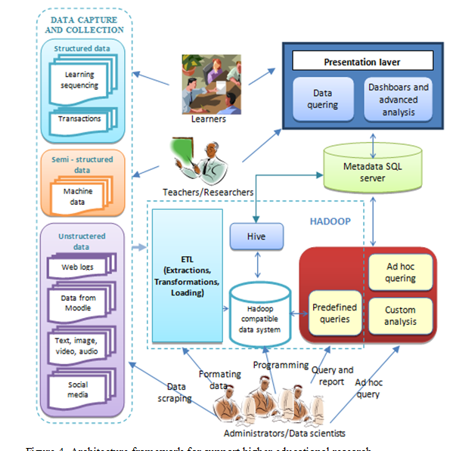
Architecture framework
Analysis engine
22

Slide 23
Challenges of Implementation Big Data in Education
Financial expenses - many institutions view analytics as an expensive effort rather than as an investment.
Monitor the entire process - from defining the important questions to developing data models for designing and delivering alerts, recommendations, and reports.
Experienced database administrators and designers capable of warehousing and incorporating data through multiple files and formats are a necessity.
In addition to the expertise needed to develop databases, instructional designers working with faculty will need to understand learner behaviors that are appropriate to the application at hand.
24

Slide 24
Challenges of Implementation Big Data in Education
Privacy, data profiling, and the rights of learners in terms of recording their individual behaviors.
Some important issues must be taken into consideration:
Should learners be told that their activity is being tracked?
How much information should be provided to students, faculty, parents, issuers of scholarships and others?
How should faculty members react?
Do learners have an obligation to seek assistance?
25

Slide 25
Conclusions
From improving learners experience and knowledge trough enhanced academic studying.
More effective evidence-based decision making.
Strategic response to changing global trends.
Provides scientists with the opportunity to comprehend the meanings of these data and how they can be analyzed in a significant, effective, and consistent manner that contributes to both theory and practice.
Promises to turn complex, often unstructured data into actionable information.
All of education organizations need to have a vision for how it will take advantage of big data.
26

Slide 26
Future work
Educational institutions - trying to balance:
various federal privacy laws
faculty expectations
the institutions own philosophy of learner development
27

Slide 27
Future work
Understand the dynamic nature of academic success and retention, offer an environment for open dialogue, and improve practices and strategies to address these issues.
Interesting additional features, which are worth for further research, can be:
optimizing presented architecture with other learning services,
identifying additional tactics, automated them and integration with cloud platform.
28

Slide 28
Thank You !

